Slide 1
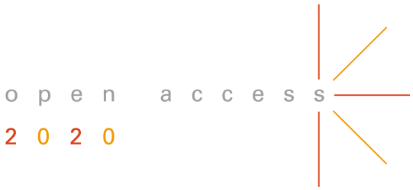
OA2020 roadmap for large-scale transformation – international
OA2020-DE Transformationsworkshop 17 October 2018 – Universitätsbibliothek Bielefeld
Ralf Schimmer
Open Access 2020 Initiative │ Max Planck Digital Library
@oa2020ini

Slide 2
Delivering open access (and value) to scholars, to our institutions, to society

Slide 3
1. Das Dilemma von Open Access

Slide 4
Das Dilemma nach 15 Jahren OA Bewegung
Open Access ist (extrem) stark verankert als Prinzip
vgl. die vielen Resolutionen, Policies, Handreichungen
…aber zugleich immer noch schwach in der Praxis
Niedrige Akzeptanzrate in Repositorien
85% der Forschungsergebnisse hinter Bezahlschranke
das Subskriptionswesen wächst ungebrochen weiter

Slide 5
Die Schlüsselfrage
Was müssen wir tun, um OA als Standard in der wissenschaftlichen Kommunikation zu verankern?
Wir können es uns erlauben, 15% von 100% entfernt zu sein. Aber es ist nicht hinnehmbar, nur 15% von Null entfernt zu sein, und das nach 15 Jahren OA-Bewegung

Slide 6
2. Über die Aktivierungsenergie neu nachdenken

Slide 7
OA auf Aktivierung des Wissenschaftlers ausgerichtet
Poli-cies
Reposi-tories
OA Jour-nals
Publi- cation funds
Man-dates
R
e
s
e
a
r
c
h
e
r
Durch Maßnahmen wie Mandate, Policies und Handreichungen sollen die Wissenschaftler zu OA bewegt werden

Slide 8
Wie wäre es mit einer Umkehr der Bewegungsenergie?
Nature
PLOS
eLife
SCIENCE
CELL
R
e
s
e
a
r
c
h
e
r
OA soll direkt zum Wissenschaftler gebracht werden, und zwar durch eine Umstellung des Geschäftsmodells möglichst aller Zeitschriften

Slide 9
Verankerung von OA als natürliche Publikationsbedingung
Nature
PLOS
eLife
SCIENCE
CELL
Nicht die Wissenschaftler sollen sich zu OA bewegen müssen, sondern durch die Änderung des Geschäftsmodells soll OA überall verankert werden

Slide 10
3. Stärkerer Hebel durch einen neuen Ansatz

Slide 11
Die Macht unserer Erwerbungsentscheidungen
Die Finanzdaten* hinter dem System der wissenschaftlichen Kommunikation zeigen
dass bereits mehr als genug Geld im System ist
Durch das Subskriptionssystem werden rund 5.000$ für jeden wissenschaftlichen Zeitschriftenartikel bezahlt
*2015 MPDL White Paper
Wenn wir unsere Macht als Autoren und in der Erwerbung nutzen, können wir den entscheidenden Systemwechsel herbeiführen und sicherstellen, dass
Forschungsergebnisse frei zugänglich & nachnutzbar sind
die Kosten transparent und nachhaltig sind

Slide 12
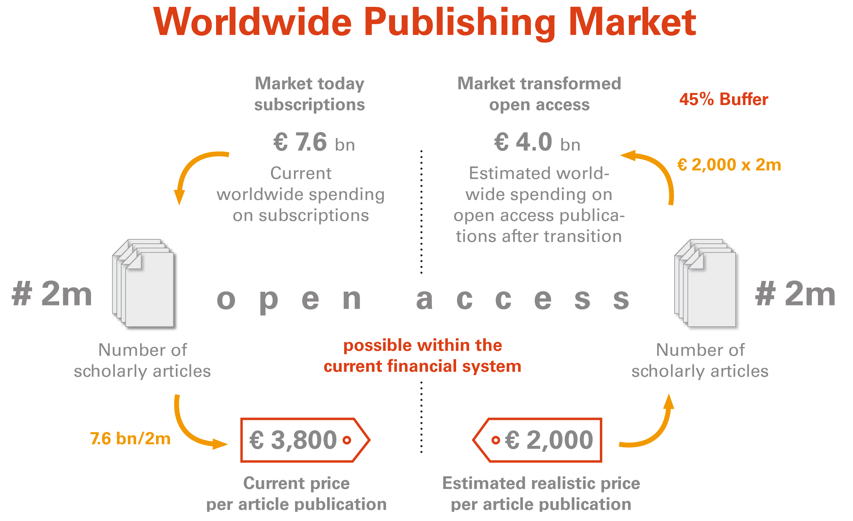
Die finanzielle Machbarkeit der Transformation

Slide 13
Ein neuer Ansatz, um OA zum Standard zu machen
Wir brauchen keine weiteren Mandate für unsere Wissenschaftler
wir brauchen ein
Mandat für unser Geld

Slide 14
Transformation bedeutet Umschichtung der Budgets sowie Umstellung der Zeitschriften und Prozesse
Global
subscription journal budget
7.6 bn EUR p.a.
(≥3,800 EUR/article)
7.6 bn EUR
2.8 bn EUR buffer for new & improved services etc. (without remaining subscriptions)
Global open access journal base budget 4 bn EUR p.a. (2,000 €/article)
Open Access volume: ~14% of articles; ~4% of budget
Remaining subscription budget 10%(~0.8 bn EUR)
Annahme 90% Konversion

Slide 15
Programmatische Verankerung im White Paper 2015
“The time is ripe for the global research community to accelerate the transition to
open access.
We have the crucial opportunity to transform the underlying business model of journal publishing while protecting the financial viability and core functionalities of the publishing system at large. Ultimately, all subscription spending must be stopped: this is the simple culmination of the incremental steps of the past decade.
The significant savings can then be reinvested for the co-creation of a range of publishing services that will truly serve the scholarly endeavors of the 21st century.”
taken from: Max Planck Digital Library Open Access Policy White Paper: “Disrupting the subscription journals’ business model for the necessary large-scale transformation to open access”. http://dx.doi.org/10.17617/1.3 (28 April 2015)
accompanying data publication: “Number of scholarly articles per country. Data on Web of Science listed articles and reviews 2004-2013”. http://dx.doi.org/10.17617/1.2 (28 April 2015)

Slide 16
Der Weg aus dem Dilemma als geordneter Übergang
Open Access im großen Maßstab lässt sich nur durch eine Umstellung des Geschäftsmodells des herrschenden Subskriptionswesens erreichen. Die Zeitschriften und die Finanzströme müssen umgestellt werden.

Slide 17
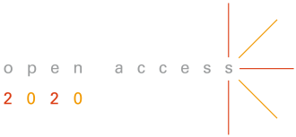
How can we deliver?

Slide 18
How can we deliver?
Archiving, Repositories, Infrastructure

Slide 19
How can we deliver?
Alternative publication venues

Slide 20
How can we deliver?
Transformative agreements

Slide 21
Build the evidence base

Slide 22
The starting point: A strong business case Enough money in the system
Subscription market today
€ 7.6 bn
Transformed Open Access
€ 4.0 bn
45% Buffer
# 2m
# 2m
scholary articles
scholary articles
Cost per article under the subscription regime
Conservative average cost per article OA publication
€ 3,800
€ 2,000
http://hdl.handle.net/11858/00-001M-0000-0026-C274-7
https://treemaps.intact-project.org/apcdata/openapc/

Slide 23
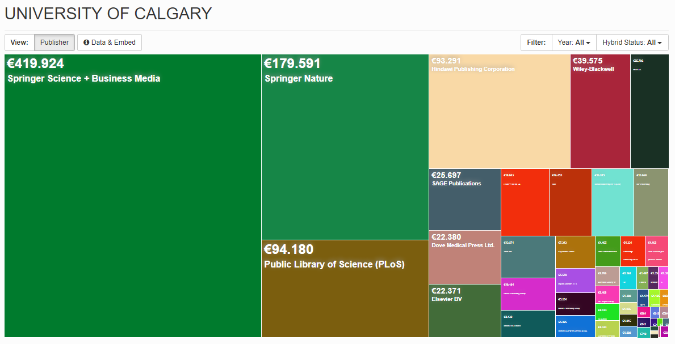
The real costs of OA publishing
https://treemaps.intact-project.org/

Slide 24
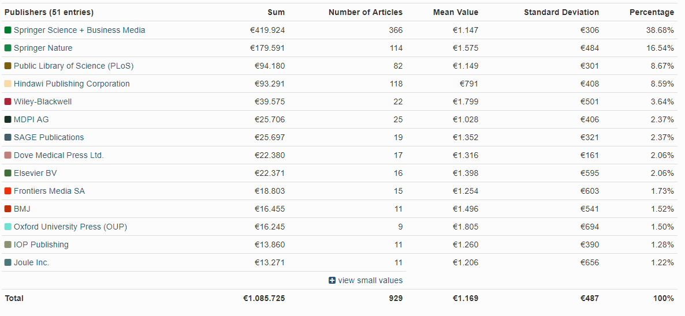
The real costs of OA publishing
https://treemaps.intact-project.org/

Slide 25
But that is not all …

Slide 26
Open access publishing is growing
CC data chart
https://www.nature.com/articles/d41586-018-05191-0

Slide 27
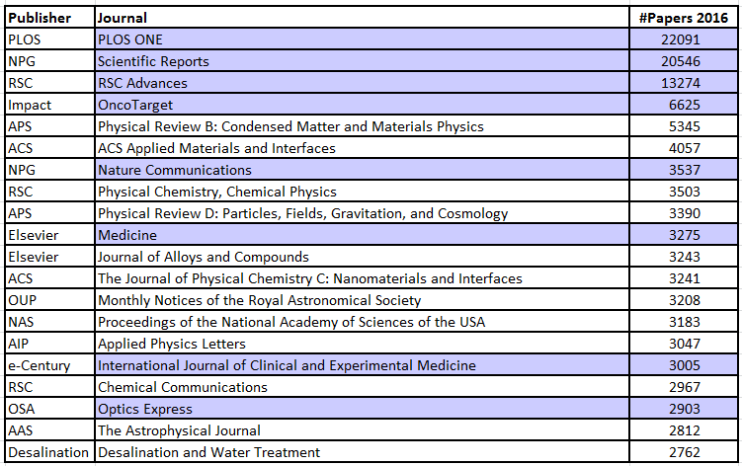
Subscription publishers are cashing in
(OA as of 2017)
20 largest journals, based on number of papers published in 2016. OA highlighted in grey.
MPDL analysis based on data from Web of Science.

Slide 28
Top 20 publishers worldwide
Number of papers published in 2016
Analysis based on Web of Science
OA dominated publisher
Rank | Publisher | Number of articles 2016 | Share of publisher 2016 | Cumulative share 2016 | Year 2016 OA Gold | Share OA Gold 2016
1 | Elsevier | 391480 | 17% | 17% | 13407 | 3,42%
2 | Springer | 185696 | 8% | 25% | 11971 | 6,45%
3 | Wiley | 142928 | 6% | 31% | 5271 | 3,69%
4 | Taylor&Francis | 83087 | 4% | 34% | 1235 | 1,49%
5 | ACS | 41929 | 2% | 36% | 102 | 0,24%
6 | RSC | 41796 | 2% | 38% | 843 | 2,02%
7 | IEEE | 38164 | 2% | 39% | 1059 | 2,77%
8 | NPG | 36615 | 2% | 41% | 25577 | 69,85%
9 | OUP | 34278 | 1% | 42% | 2914 | 8,50%
10 | LWW | 26909 | 1% | 43% | 0 | 0,00%
11 | PLOS | 25248 | 1% | 45% | 25248 | 100,00%
12 | BMC | 25098 | 1% | 46% | 24944 | 99,39%
13 | Sage | 24423 | 1% | 47% | 252 | 1,03%
14 | AIP | 20920 | 1% | 48% | 1504 | 7,19%
15 | IOP | 20834 | 1% | 48% | 1139 | 5,47%
16 | APS | 18086 | 1% | 49% | 419 | 2,32%
17 | MDPI | 15683 | 1% | 50% | 15683 | 100,00%
18 | CUP | 14467 | 1% | 50% | 157 | 1,09%
19 | Hindawi | 12350 | 1% | 51% | 11158 | 90,35%
20 | Frontiers | 11115 | 0% | 51% | 11115 | 100,00%
 | Other | 1141171 | 49% | 100% | 137710
 | Total | 2352277 |  |  | 291708
20 largest publishers, based on number of papers published in 2016. OA highlighted in grey.
MPDL analysis based on data from Web of Science.

Slide 29
Financial impact of OA publishing
OA publishing constitutes an unmonitored and unchecked parallel revenue stream for subscription publishers
+ 10
7.6 Bn EUR
+ 100
2M # articles
+ 1000
3800 EUR per article

Slide 30
To break the system, both money streams must be reined in
OA is (just) the next step in the evolution of licensing
subscriptions
OA publishing

Slide 31
Create a strategy
Divest of subscriptions - Invest in open access
subscriptions
subscriptions
subscriptions

Slide 32
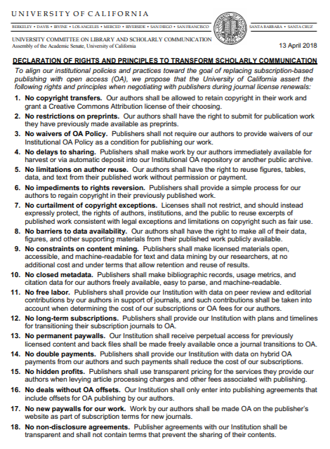
Engage stakeholder at all levels
Declaration of Rights and Principles to Transform Scholarly Communications
Championing Change in Journal Negotiations
Negotiating Journal Agreements at UC: A Call to Action
https://osc.universityofcalifornia.edu/2018/06/championing-change-in-journal-negotiations/

Slide 33
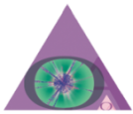
Invest in open access

Slide 34
Transformative agreements
+
Subscriptions
Open access

Slide 35
Transformative agreements
Subscriptions
Open access
Subscriptions
Open access

Slide 36
Mechanism of transformative agreements

Slide 37
Temporary and transitional
Publisher represents that the Read & Publish model, with its foundation in “hybrid” open access – where some articles are paywalled and others published open access – is a temporary and transitional business model whose aim is to provide a mechanism to shift over time to full open access.
The Publisher commits to informing Customer of progress towards this longer-term aim on an annual basis, and to adjusting Read & Publish terms based on its progress towards full open access.

Slide 38
Pareto principle works to our advantage
Costs
8 biggest publishers 70%
Smaller publishers 20%
Rest
10%
Number of publishers
What VSNU is working on

Slide 39
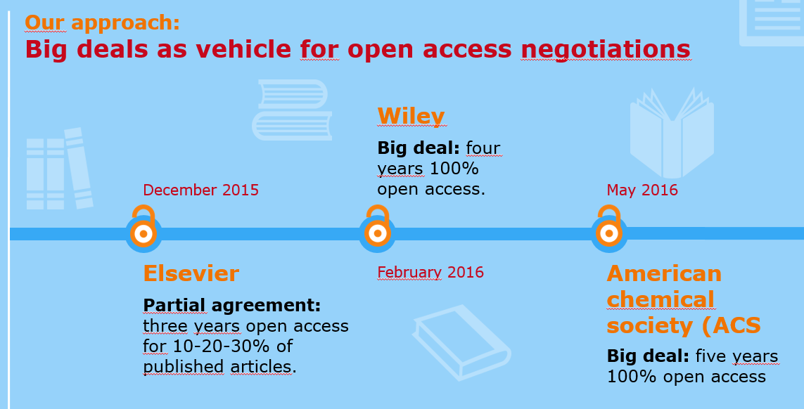
VSNU approach

Slide 40
CDL approach

Slide 41
MIT approach

Slide 42
Prepare for negotiations

Slide 43
Financial leverage: there is already enough money in the system
Subscription market today
€ 7.6 bn
Transformed Open Access
€ 4.0 bn
45% Buffer
# 2m
# 2m
scholary articles
scholary articles
Cost per article under the subscription regime
Conservative average cost per article OA publication
€ 3,800
€ 2,000
http://hdl.handle.net/11858/00-001M-0000-0026-C274-7
https://treemaps.intact-project.org/apcdata/openapc/

Slide 44
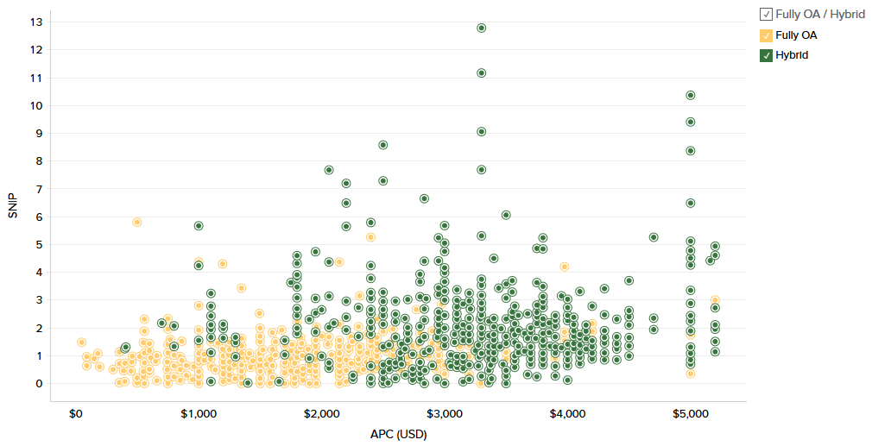
Additional leverage in APC data evidence
APC vs. SNIP for Publishers by Fully OA/Hybrid:
All publishers (2017-2018)
Average list APC
Fully OA: $1600
Hybrid: $2900
Average payment tracked by OpenAPC:
Fully OA: €1488
Hybrid €2445
With permission from Delta Think Open Access Data & Analytics tool. Analysis 15.09.2018

Slide 45
Additional leverage in shared knowledge
Pure gold APCs reflect production costs and services whereas hybrid APCs reflect current revenues and profit margins of the subscription business
APC price points are not justified by value indicators such as SNIP
Median APC price points are the key drivers in the overall evolution of costs and need to be closely monitored
http://esac-initiative.org/wp-content/uploads/2018/07/esac_apc_workshopIII_outcome_report_final.pdf

Slide 46
Additional leverage in decreasing value of subscriptions
https://www.slideshare.net/HenrikKarlstrm1/expanded-usage-metrics-for-literature-resources-105601917

Slide 47
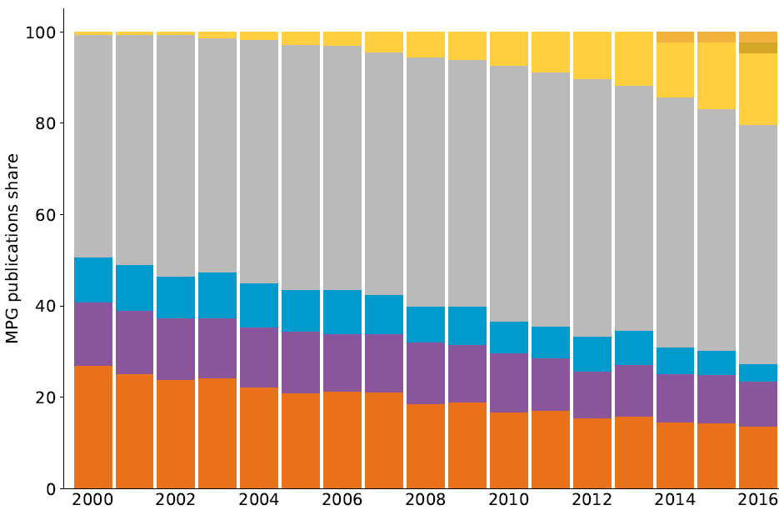
Additional leverage in growth trend of open access publishing

Slide 48
Additional leverage in timing and public opinion
http://science.sciencemag.org/content/sci/361/6406/957.full.pdf
https://www.nature.com/articles/d41586-018-05754-1
http://www.sciencemag.org/news/2017/10/german-researchers-resign-elsevier-journals-push-nationwide-open-access

Slide 49
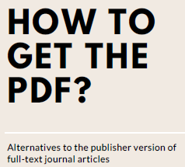
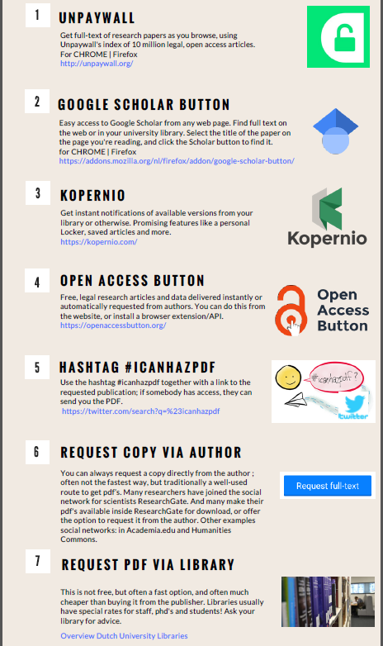
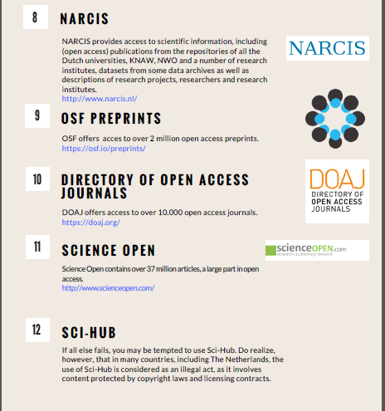
Stepping away from the table IS an option
http://www.openaccess.nl/sites/www.openaccess.nl/files/documenten/howtogettothepdf_march_2018.pdf

Slide 50
Collaborate and align strategies

Slide 51
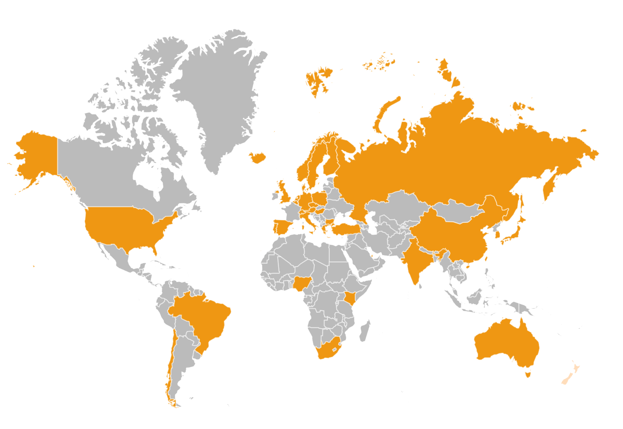
The global Open Access 2020 Initiative

Slide 52
A global initiative to meet publishers
at eye level

Slide 53
Libraries are best positioned to
manage the transition
52

Slide 54
Our destination
Cost transparency and a competitive market in which our money can follow scholars, not publishers.

Slide 55
Our destination
Finally, open access on a large-scale.
For our scholars, for society.

Slide 56
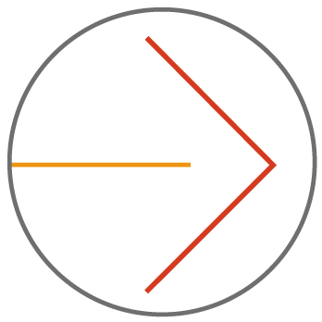
Ready to start?
Participate in OA2020
Accelerate the transition
https://oa2020.org/

Slide 57
Thank you!
Ralf Schimmer
Open Access 2020 Initiative
Max Planck Digital Library
schimmer@mpdl.mpg.de
https://oa2020.org

